Slide 1

Pre-Retirement Planning
Teamsters Local 237
Retiree Division
Pre- Retirement online Series
Spring 2021
Session 1
introduction

Slide 2
Overview
Understanding the retirement process
Types of retirement
Steps for retirement
Link to NYCERS comprehensive guide
Resource guide
Contact information

Slide 3
Types of Retirement
Service retirement- is based your plan, age and years of service.
Disability retirement- is based on an accident or medical condition and 10 years of credited service. Accident disability has no service requirement.
Retiree Division staff can assist you with your disability application.

Slide 4
Thinking of Retirement…
Retirement is a personal decision. Only you can decide when the time is right.
Before retirement things you may want to consider:
  Finances
  Outstanding loans
  Budgeting
  Review of monthly expenses and assets.
  Keep in mind retirement is not for a day or a week only. Many Local 237 retirees have been enjoying retirement to 20 years or more.

Slide 5
Thinking of Retirement continues…
Review your health insurance
  Are you going to become eligible for Medicare?
  Once you become eligible for Medicare a copy of you card needs to be submitted to Union welfare fund and to the office of labor relations.
  The city will reimburse you for your Medicare part B premium. (See session 2 for more information on Medicare reimbursement)

Slide 6
Retirement Process
When thinking about retirement….
  At least 3 month before you would like to retire contact your agency. This is to inform the agency you would like to retire.
  File your retirement application with NYCERS or BERS.
  Meet with your employee benefits or Human resource department to complete your health benefit application.
  Obtain pension estimate from NYCERS or BERS regarding your pension. This will help you decide when is the right time.

Slide 7
Steps to complete
Please note: This is the current process due to office closures. Check with offices for updates. Email a copy NYCER or BERS confirmation , a copy of your health benefit application, retiree enrollment form**, Medicare card if applicable via email to welfareinfo@local237.org
Provide a copy of your NYCERS or BERS confirmation and copy of your health benefit application to the Office of Labor relations via secure website at www.nycemployeebenefits.leapfile.net (please note: this is not an email address it is a secure website).
Keep copies of all you documents.
**See forms section on the website.

Slide 8
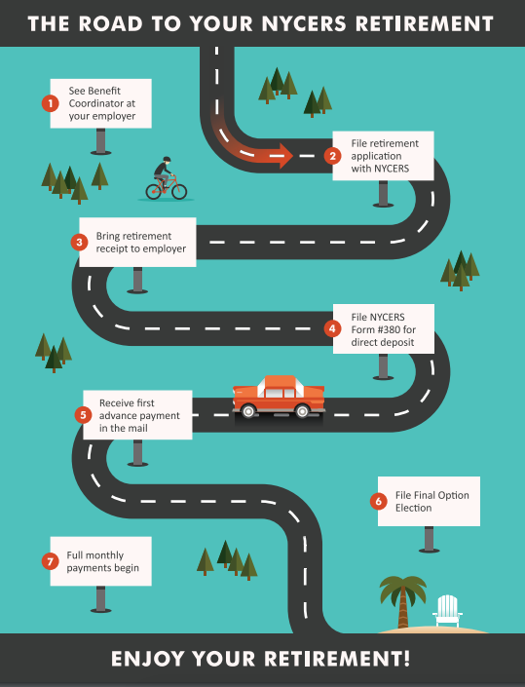
NYCERS Road to Retirement

Slide 9
NYCERS Pre- Retirement information
NYCERS
Please Note: NYCERS is currently open by appointment only. To schedule an appointment you can call, or use your my NYCERS account to make an appointment. If you need paper forms mailed to you contact 347-643-3000 or visit the NYCERS website www.nycers.org
For a comprehensive pre-retirement tier 4 booklet please see link below
https://www.nycers.org/sites/main/files/file-attachments/civilian_comprehensive_pre-retirement_booklet_2020.pdf?1585684850
(please note you can search for information on your tier on the NYCERS website)

Slide 10
BERS Retirement information
By Phone Give us a call at: (929) 305-3800 or, for those outside New York State,
call: 1-800-843-5575 to be directed to one of our helpful representatives.
Call Center hours are from 9 am to 5 pm.
By FAX
Please note that BERS has two fax numbers. The numbers are
(718) 935-4124 and (718) 935-3830.
By E-Mail Brespon@bers.nyc.gov
Location
Board of Education Retirement System
65 Court Street, 16th Floor
Brooklyn, NY 11201-4965
Please note, BERS is closed to the public “until further notice” due to the coronavirus pandemic

Slide 11
Resources available to you
Pension counseling available via telephone. The pension counselor is available by appointment only. To schedule an appointment please email retirees2@local237.org
Stacey Braun offers free consultation with a Financial planner. Contact information: 888-949-1925 (for active members only)
Attend the Pre- Retirement seminars held at the union twice a year. Dates to be determined.

Slide 12
Retiree Division
Retiree Division staff are here to help should you have any questions or concerns about the retirement process. Retiree Staff is available via telephone at 212-807-0555 or via email retirees2@local237.org
The Retiree Division will remain available to you for the rest of your life.
The Retiree Division slogan “retired from work, not the union. “

Slide 13
Important Contact information
Office of Labor Relations
22 Cortlandt Street 12th floor NY, NY 10007 (Office is closed)
For questions of concerns email healthbenefits@olr.nyc.gov
Local 237 Welfare Fund (Office is closed)
216 West 14th Street NY, NY 10011
Welfare email: welfareinfo@local237.org

Slide 14
Retiree Division Contact information
Local 237 Retiree Division
216 west 14th street 8th Floor
NY, NY 10011
212-807-0555
Email: retirees2@local237.org

